Slide 1
Blitz Classification
CSE 611 Summer Project
Alain Schaerer
Li-Hsuan Hsieh
Khushmeet Singh
Jiun Kim
Piyoosh Kumar

Slide 2
Introduction
Blitz - defense tactic used to disrupt pass attempts by offense.
Bring more men than offense is prepared to block.
Blitzer can be anyone, but usually is safety or linebacker.
Blitz is often a surprise attack that forces the offense into incomplete passes or tackles for losses.
Drawback of blitz - takes away the defender from the coverage

Slide 3
Goals
Identify blitz occurrence using 2021 NFL play data
Identify the blitz type (gap, position of blitzing players, cross) for a given play
Draw an animation for the given play
Find blitz indicators
  Example - Safety-Linebacker cross blitz from A and B gap

Slide 4
Blitz definition
We use columns personnelD and numberOfPassRushers from play.csv to help us define which play has blitz.
personnelD: This column shows that how many players in each position for the defensive team. Ex: 4 DL, 2 LB, 5 DB
numberOfPassRushers: Number of pass rushers
With personnelD, we can know how many defensive linemen in the play and if the number of pass rushers is greater than the number of d-linemen. Then we consider the play has blitz
We filtered some plays that personnelD contained too many or less d-linemen.

Slide 5
Gap Detection (Which gaps do the blitzes go to)
We want to know which gap the blitzers go to classify blitzes
Gap definition:
  Use quarterback’s location to determine the middle point of the offensive team’s format
  The gap would extend from the middle point and the distance of each gap is two yards
  Ex: F - - E - - D - - C - - B - - A - - M - - A - - B - - C - - D - - E - - F
Once we know where the gaps are, we can count how many players go pass each gap by using the tracking data
  Check the horizontal coordinate (y) to determine which gap the player at
  Check the vertical coordinate (x) if the player is in the range between LOS and 1.5 yards behind the LOS

Slide 6
Cross Blitz Detection (Do the defenders cross when blitzing?)
Get the combinations of two players with nflId in blitzers. Ex: [‘123’, ‘234’, ‘345’] the combination will be [(‘123’, ‘234’), (123, ‘345’), (‘234’, ‘345’)]
For each combination, use the location when event ball_snap occurred and the location when the player cross the gap to determine if the the two players crossed (a initial y > b initial y and a y in gap < b y in gap) each other during the play.

Slide 7
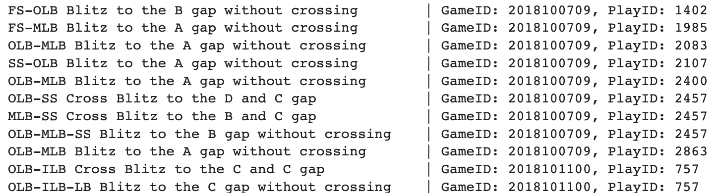
Results
We tested our method with PHI data and check some plays with our visualization to validate

Slide 8
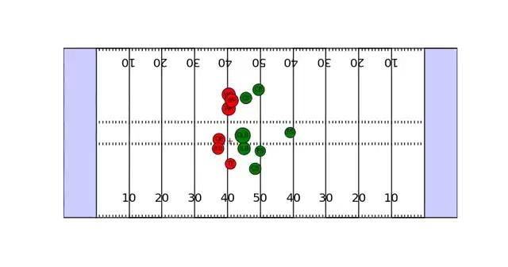
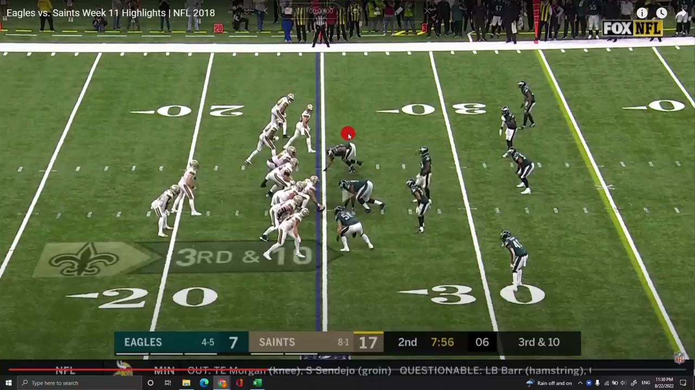
Example Play

Slide 9
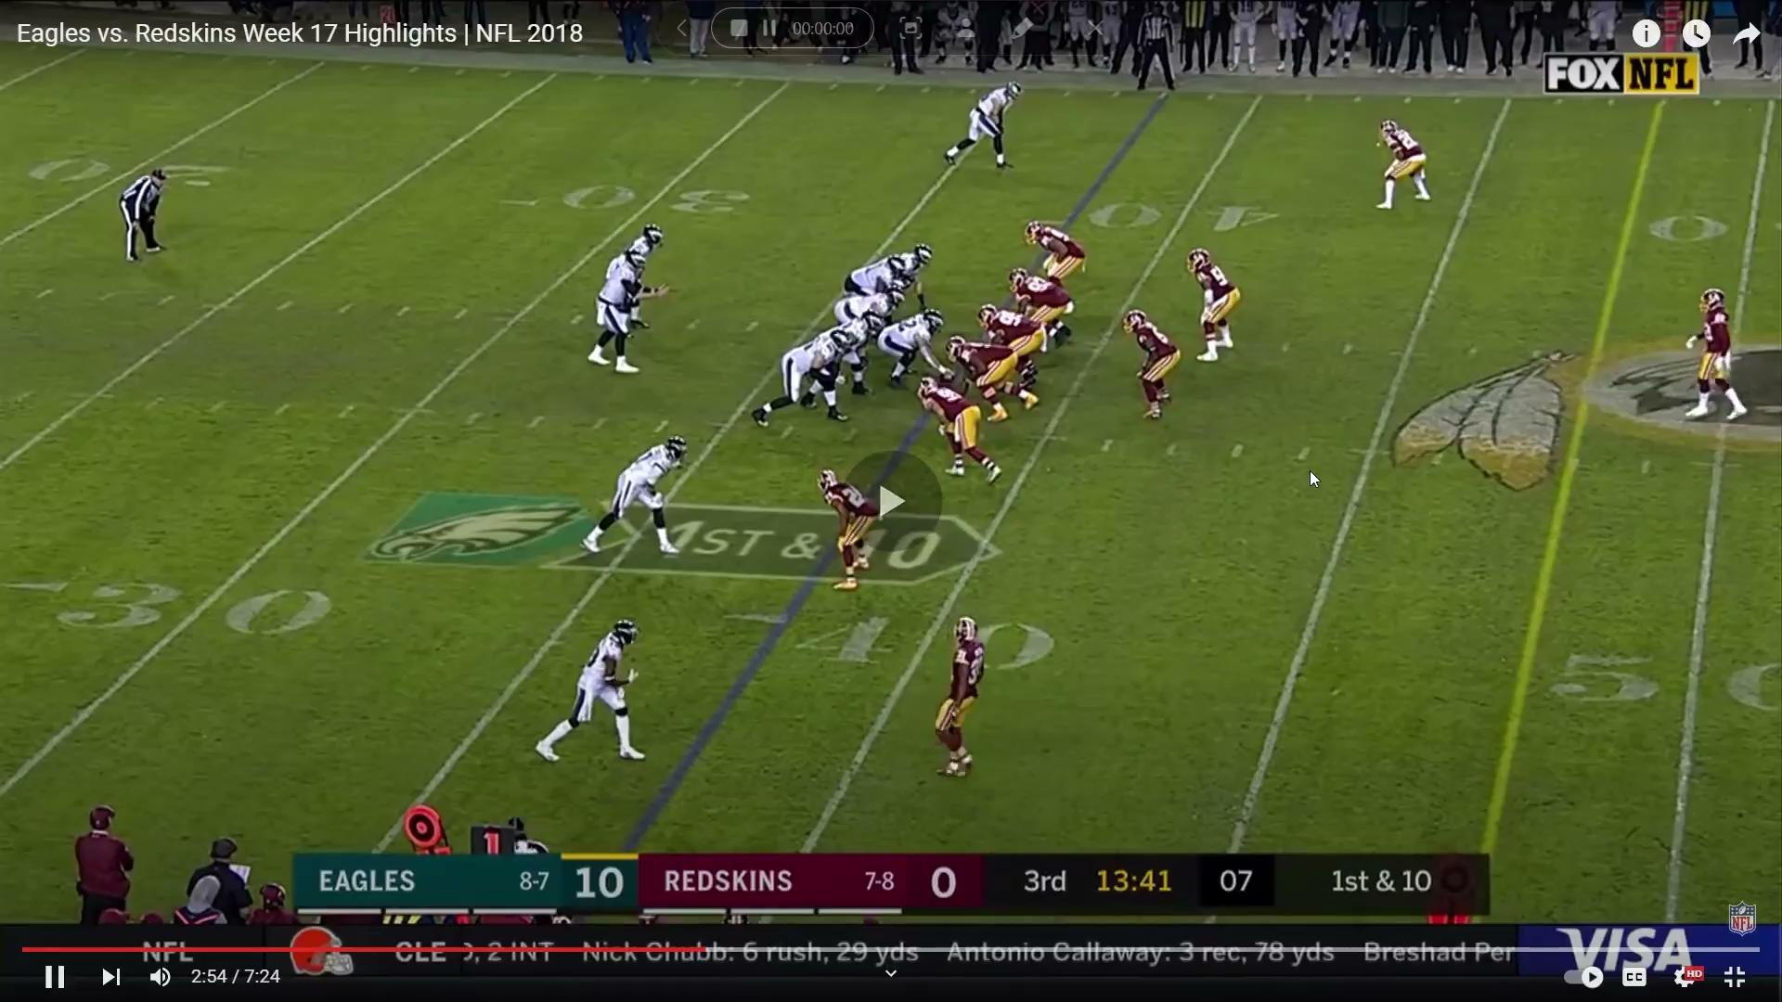
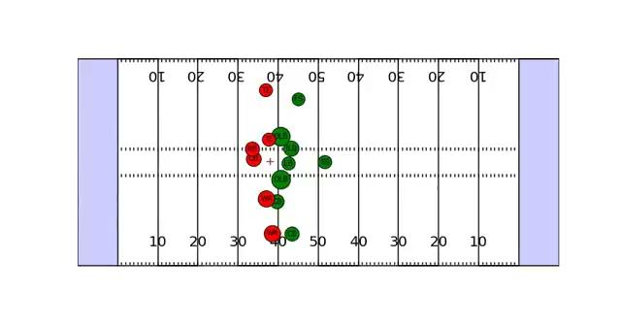

Slide 10
Challenges Faced
No offensive linemen data
  Had to estimate gap area
No defensive linemen (tracking) data
  Some players were marked as "DL" but they were actually just linebackers walked up to the LOS.
  Some actual defensive linemen were marked as "LB."
  Those two inconsistencies lead to fronts with 6 or more "defensive linemen" or fronts with 3 or less defensive linemen, which do not exist in football. A 6 up front is usually 4 defensive linemen with 2 walked up linebackers and I have never seen a front with less than 3 actual defensive linemen.

Slide 11
Future Improvements
Find a way to more accurately estimate gap areas in general.
Find a way to estimate gaps, even for plays where gaps get heavily stretched.
Find a way around personnel problematic (6 DL fronts etc.)
All of these problems would be solved with offensive and defensive lineman tracking data and more football knowledge from the nfl data science employees.
Implement indicator detection.

Slide 12
Thank You

